Slide 1

Vision
Sunday
TODAY

Slide 2


Slide 3
Acts 2:42-47

Slide 4
There are certain elements that characterize a real church

Slide 5

In order to be a real church we need to strive to be:
A church that is in continual devotion to the Lord
A church that is in continual devotion to the Lord’s people
A church that is in continual devotion to the Lord’s work in the world

Slide 6


Slide 7


Slide 8


Slide 9


Slide 10

Reflections

Slide 11


Slide 12


Slide 13












Slide 14


SOUTHSIDE BAPTIST CHURCH
6:30 -9:00
October 25th

Slide 15
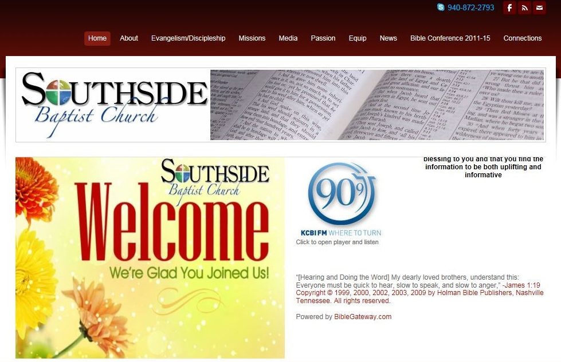

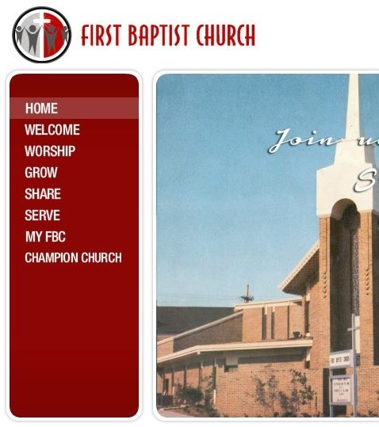

EQUALS
One Service at Southside
November 5th PM

Slide 16
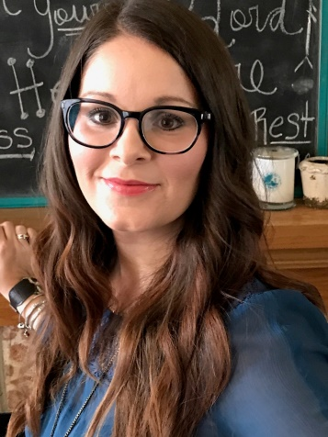

MARCH 3, 2017
LADIES BANQUET
LouAnn Rogers

Slide 17
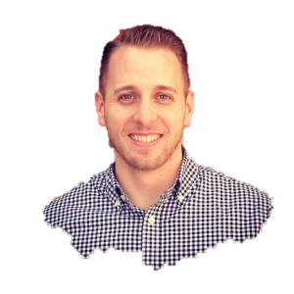
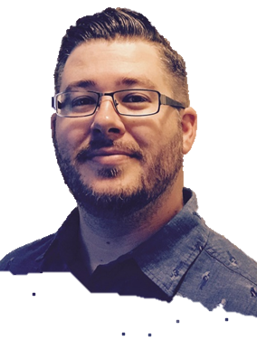
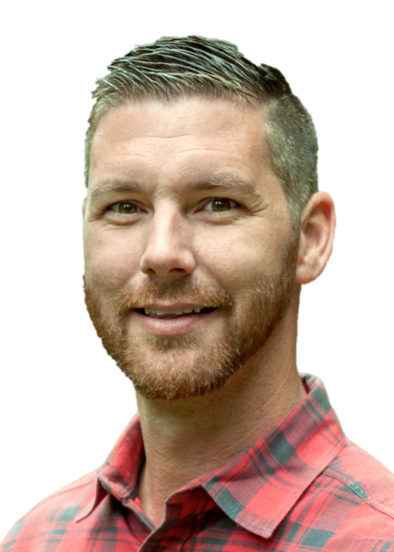
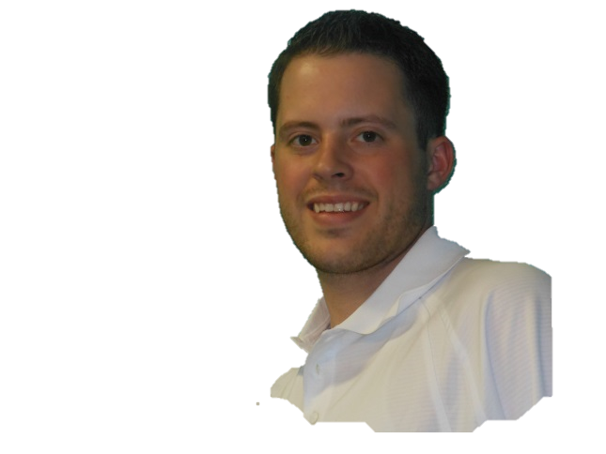
MARCH 4-7, 2017
BIBLE CONFERENCE
Jordan N. Rogers Pastor, Hillcrest (Nederland)
Dr. Andrew Hebert Pastor, Paramount (Amarillo)
Dr. Shane Pruitt SBTC Director of Evangelism
Dr. Jeremy A. Rogers Pastor, Arlington Park

Slide 18
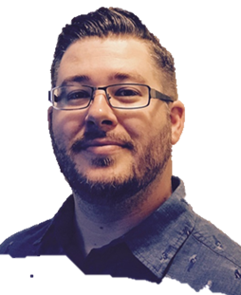
MARCH 4-7, 2017
POWER LUNCH
Jeremy A. Rogers Jordan N. Rogers

